Slide 1

Risky Business:
Suicide Prevention &
Marketing Tools
May 4, 2010
Colbie Van Eynde, MPH
Suicide Prevention Project Coordinator
cvaneynde@npaihb.org

Slide 2
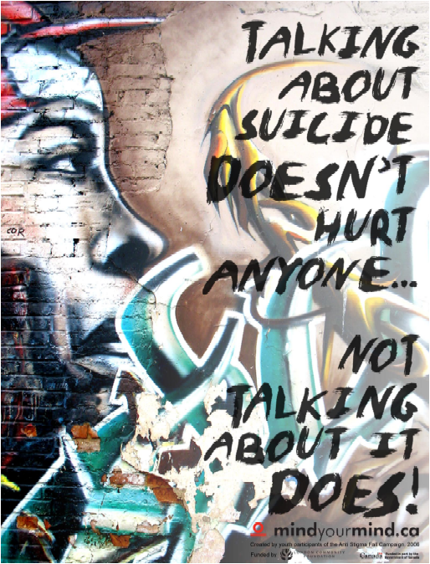
NPAIHB Next Steps
NPAIHB will soon begin work to develop regional suicide prevention, awareness, & outreach materials:
  Print Fliers, Brochures, Posters, Factsheets?
  Videos?
  Social Marketing Materials?
  Social Media Materials?
  Toolkits, Guides, Curricula?
Notes:
-NPAIHB will implement suicide prevention activities upon request among the 43 federally-recognized tribes in Oregon, Washington, and Idaho, leading to measureable, positive outcomes for at-risk American Indians and Alaska Natives (AI/AN).

Slide 3

Social Marketing – Development Process
Environmental Analysis
Plan Marketing Strategies
Product Development
Implementation
Evaluation
Notes:
-These are the steps in our social marketing development process

Slide 4
Social Marketing – Development Process
Environmental Analysis
  Create a vision for change.
  Identify the target market. Whose behavior are you trying to change and why?
  What are the demographics?
  Focus on the consumer’s needs. What interests them? What do they want? What motivates them? What do they avoid? What are their personalities?
Notes:
For this first step, environmental analysis, these questions usually get answered.

Slide 5
Social Marketing – Development Process
Environmental Analysis…
  From May 20-June 20, 2008, the Community Readiness Assessment was completed by 25 people representing 11 Tribes in the Pacific Northwest and 7 partnering agencies
Notes:
For our environmental analysis we created a Community Readiness Assessment. . . .
-A Community Readiness Assessment was conducted from May 20-June 20, 2008 and was completed by 25 people representing 11 Tribes in the Pacific Northwest and 7 partnering agencies. When asked about weaknesses in their existing AI/AN suicide prevention and treatment services, respondents noted the following:
1) Existing suicide prevention services are not well accessed or utilized by community members
2) There is a general lack of awareness about mental health services among community members regarding what they provide and how it is provided. Suicide prevention programs need to be more accommodating and more visible.
3) Suicide prevention training is needed at all levels, targeting tribal decision-makers, service providers, elders, families, and schools.
4) Improved communication must be forged between service providing agencies at the tribal-level to improve coordination and efficiency.
5) Mental Health Programs must integrate traditional healing practices to improve their cultural competence.
6) Transitional programs are critically needed for teens and young adults leaving treatment centers (often in distant or urban locations), to maintain their sobriety and mental wellbeing once they return to their tribe.

Slide 6
What is the Prevailing Attitude Toward Suicide in your Community?
I really believe - because our family had to go through this as well - that we accept it, but are totally overwhelmed with unanswered questions.
I would guess action and acceptance.
It’s not talked about.
Silence - they do not want to acknowledge the problem.
Silence, if we don't talk about it, it will go away
Silence, stigma, worry (n = 5)
Silence...worry...anger, but not unconcerned
Worry, silence, action and confusion
Silence about the problem, worry when someone attempts suicide, and then anger when suicides happen.
Notes:
From the assessment participant’s we found these patterns that can be used to create suicide prevention messaging. These should guide our social marketing messages.

Slide 7
Small Groups: Social Climate
What are we afraid of? What is driving the Fear?
What are we being silent about? What should we be talking about?
What about Stigma?
  Mental illness?
  Depression?
  Asking for help?
  Using your tribe’s mental health services?
Notes:
Past discussions:
--Yes there is still stigma
--Students feel angry when their friend(s) attempt suicide
--It is hush, hush and blame is given to something/someone, at reservation
--Kids on Rez keep pretty quiet about suicides that occur
--Families need more education so no blame occurs
--Alcohol connected- education on this as well
--Using Natives to tell their story of their attempt and the impact of it on their life (Andrew Thomas)
--Parents think kids will try it if they talk about it
--Kids feel afraid to talk to parents about suicide, depression because they feel parents will judge them
Do you agree with the attitudes from the last slide and from the past discussions we have had? Do you feel differently?
What drives the fear we have to talk about suicide and depression?
What needs to change?

Slide 8
Target Audience Consensus
Youth
Adults
Elders
Parents
Teachers
Healthcare Providers
Tribal Council Members
Notes:
Since we have been polling various Tribal staff and Tribal members during meetings and trainings, the top two audiences that Tribes feel our social marketing tools need to target are youth and parents.
We will be creating materials that reach out to other groups as well but we would like to develop the ones for youth and parents first.
Do you all feel that these are the two most important groups to target first? If no, what group is most important to you? Why?

Slide 9
Examples of Products
we could develop….

Slide 10
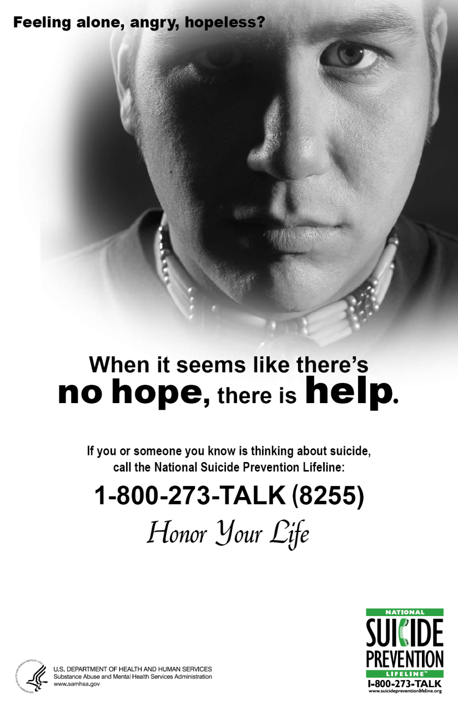
Notes:
National Suicide Lifeline
Their messaging “When it seems like there’s no hope, there is Help”

Slide 11
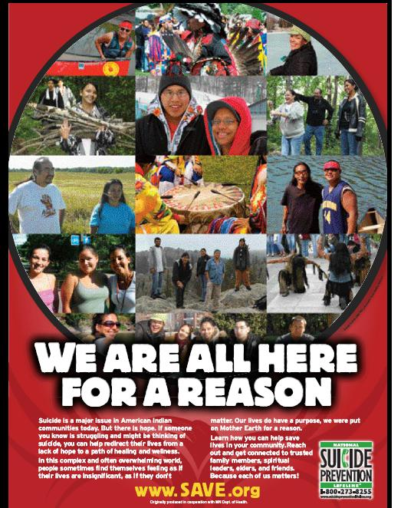
Notes:
SAVE- Suicide Awareness Voices of Education
Messaging “We are all here for a reason”

Slide 12

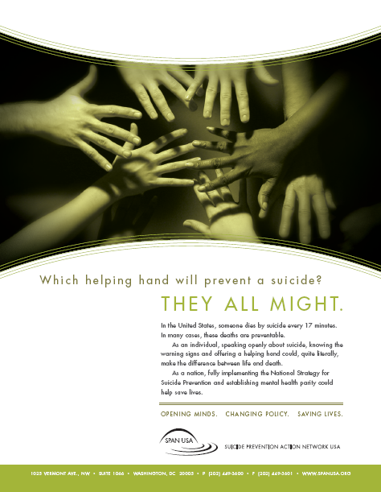
Notes:
SPAN USA- Suicide Prevention Action Network USA
Messaging “A suicide may be a personal act, but we all feel its effects” and “Opening minds. Changing policy. Saving lives.” and

Slide 13

Notes:
Mind your mind.ca from Canada
Messaging “reach out. . .get help. . .give help”

Slide 14


Notes:
Messaging: Don‘t Erase Your Future

Slide 15
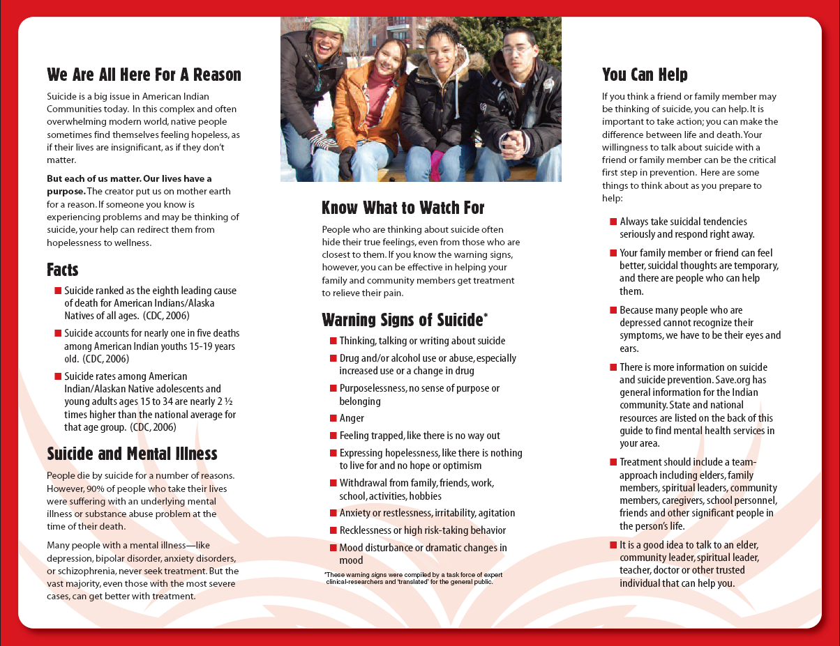
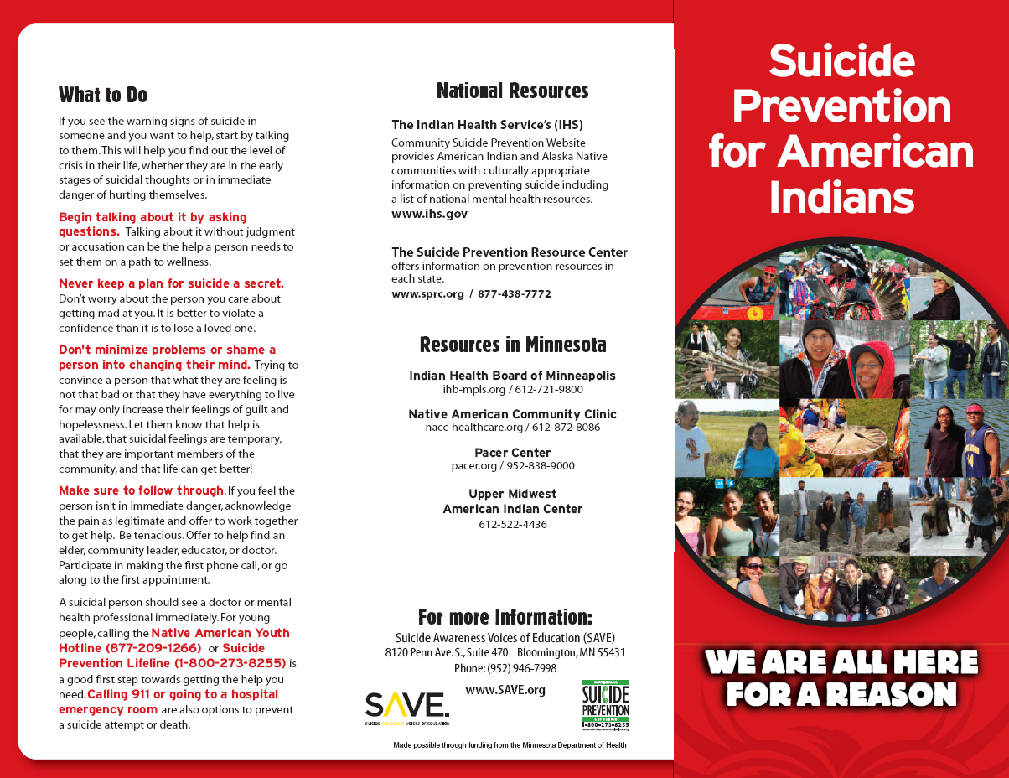
Notes:
SAVE- Suicide Awareness Voices of Education

Slide 16
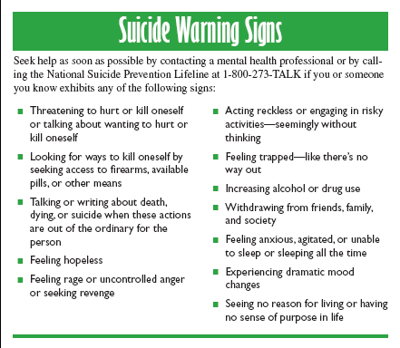
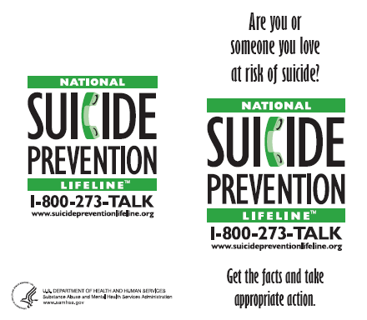
WALLET CARD
Notes:
National Suicide Lifeline

Slide 17

When
Darkness Calls
Automated video available in Gitxsan
at: http://www.youtube.com/watch?v=8sZ2MgmeKdU
Picked on by school bullies, misunderstood by his teacher and chastised by his parents, Kyle is about to make the choice of his life - whether to take his own life or not.
Notes:
The Healthy Aboriginal Network: Darkness Calls Comic Book
http://www.thehealthyaboriginal.net/
“The Healthy Aboriginal Network creates comics on health and social issues for youth.” - Healthy Aboriginal Network Homepage, 2009. Comic books are available for $5.00 and cheaper when bought in bulk.

Slide 18
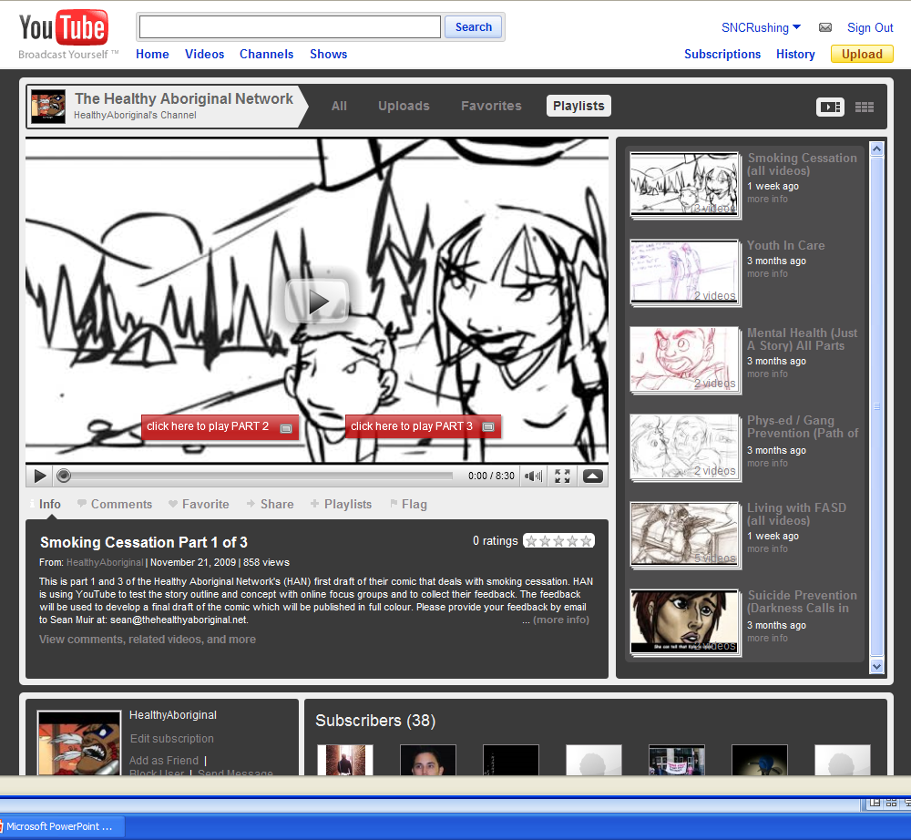

Slide 19
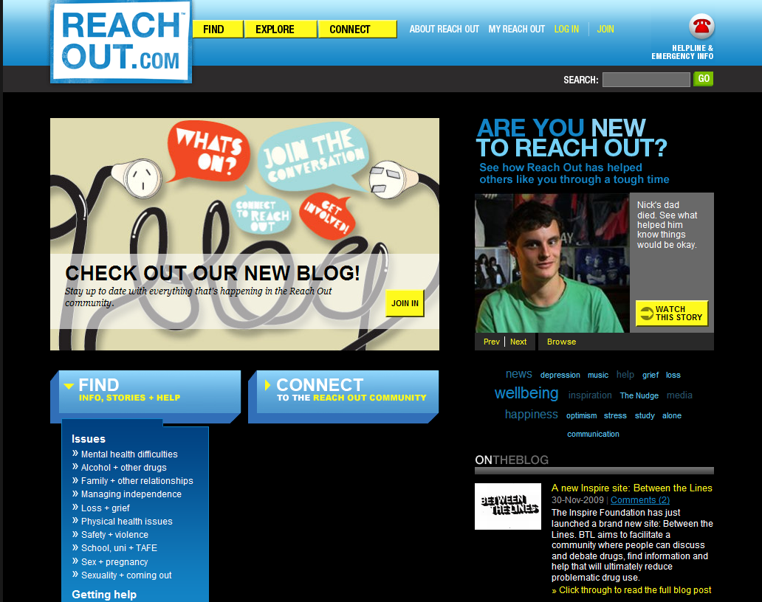

Slide 20
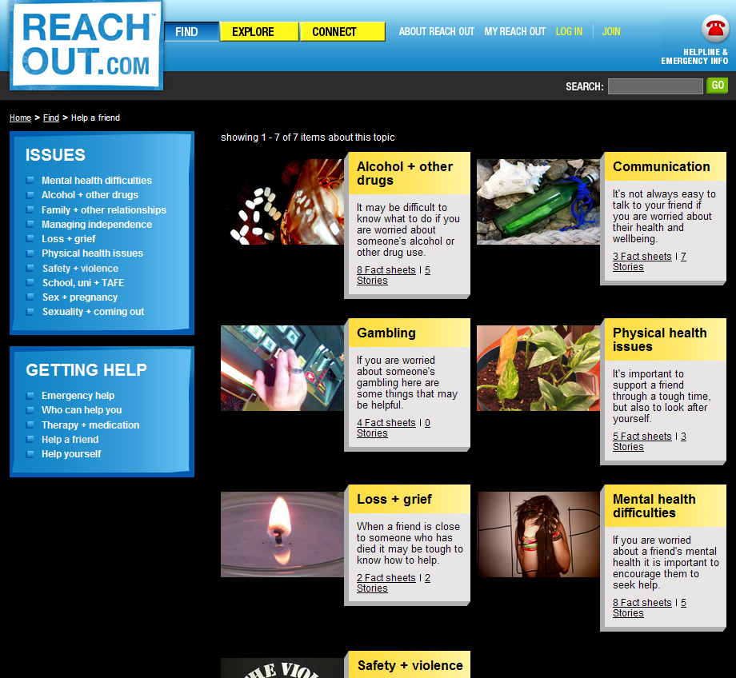

Slide 21
Do Native
- youth, adults, elders –
call the hotline?
If not, do we need other crisis response tools?
Notes:
National Suicide Lifeline
What do you think of suicide hotlines? Are they utilized? If so, by who? (elders, youth, adults)
((Is it cost-effective and does it help enough people for us to put more time/energy/money into the hotlines?))

Slide 22
Materials Consensus
Flyer or Poster
Brochure
Wallet Card or Business Card
Short Video
Public Service Announcement
Comic Book
Multimedia Website
Notes:
Since we have been polling various Tribal staff and Tribal members during meetings and trainings, the top materials that Tribes feel our social marketing tools need to create are Fliers and Posters, followed by Comic books, short videos, and multimedia websites.
PSAs were questioned by those Tribes that do not have their own radio station.
We will be creating most of these materials but we would like to develop these top materials first. We have money each year for three years and this year we would like to create the print materials that were identified as a need here and over the next two years we would create other materials including a multimedia website.
Do you all feel that these are the materials that your community will respond to best? If no, which method would work for your community?

Slide 23
What other products would help us reach our target audience?

Slide 24
Plan Marketing Strategies
Marketing Strategies
  Product – What is your message?
  Price – What is the cost of this behavior/attitude/knowledge change?
  Promotion – How will you get the message out?
  Placement – Where will you place the message?
  Branding – do all related offers/messages have the same look and feel?
  Traditional Promotion – posters/brochures/give-aways
  Public Relations – Radio and television PSAs, Op-Ed pieces
  Advertising – paid space in print, radio, and television
  Nontraditional media – videos, blogs
Notes:
Step 2 is To identify possible marketing strategies. To do this we need to identify our:
product
price
promotion
placement
Then we can:
brand it
use traditional promotional techniques
use public relations channels
pay for advertising
use non-traditional media channels

Slide 25
Social Marketing – Development Process
Product Development
  Test campaign messages: feedback, focus groups, and surveys
  Are the messages credible? Can they be recalled?
  Is there a direct call to action?
  What emotion is evoked?
Implementation
Evaluation
Notes:
3rd Step is Product Development. The next slides give us tips on how to develop messages for the social marketing tools we would like to create.
-We have money for the next 3 years to develop various social marketing tools.

Slide 26
Messaging: Just the Facts…
Simple factual statements increase knowledge retention and positive behavioral intentions.
Suicide prevention practitioners should use simple factual statements such as:
  Suicide can be prevented.
  There are almost always warning signs that someone is thinking about suicide.
  Always take a threat of suicide seriously and get help.
www.sprc.org/library/mythposter.pdf, SPRC, 2010

Slide 27
Special considerations for suicide prevention messaging…
Emphasize help-seeking
Provide information on finding help
Emphasize prevention
List the warning signs of suicide
List risk and protective factors
Highlight effective treatment for mental health problems
Safe and Effective Messaging, SPRC, 2006

Slide 28
Special considerations for suicide prevention messaging…
Emphasize help-seeking
Provide information on finding help
Emphasize prevention
List the warning signs of suicide
List risk and protective factors
Highlight effective treatment for mental health problems
Safe and Effective Messaging, SPRC, 2006

Slide 29
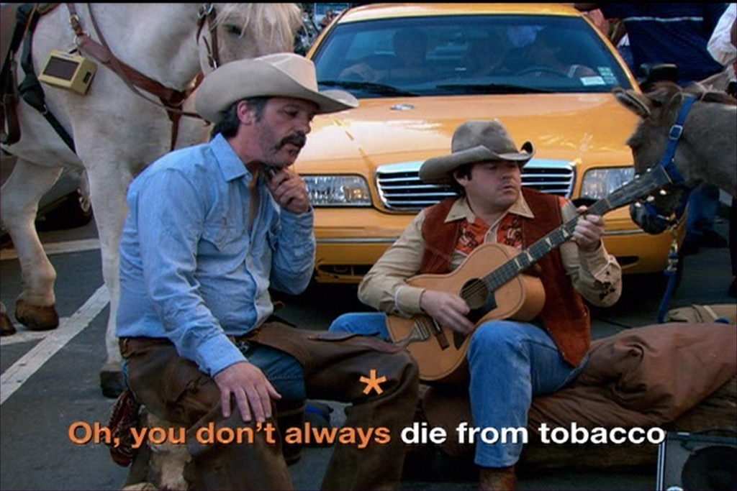
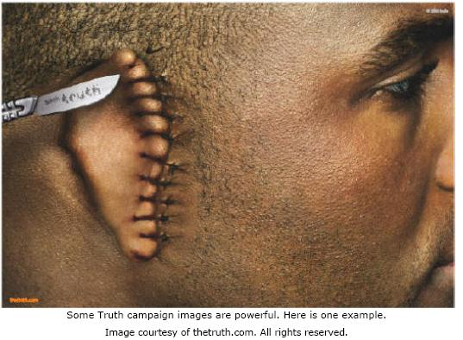
Messages That Stick…
Simple – use analogies
Unexpected – develop jarring, unexpected messages
Concrete – use specific language and details
Credentialed – rely on authorities or testable ideas
Emotional – tap into negative or positive feelings
Stories – tell stories about real people
Safe and Effective Messaging, SPRC, 2006

Slide 30
Small Groups: What messages about suicide are needed for this Target Audience?
In Order to Help: (target audience) ____________________________________________
To DO: (behavior or action) ____________________________________________
Our Sticky Message will be:
Notes:
Split into 2 groups- one to create messages for Youth
and other to create messages for Parents
-Please include a couple positive affirmations such as “have you hugged a your kid today”
This is to create campaign messages- use the ideas from slide 6 (attitudes) to form these messages. Examples were on the previous flyer and poster slides i.e. “We are all here for a reason”

Slide 31
Regional Youth Training Week
Possible Opportunity
Use next year’s MSPI Cooperative grant funds
Art, Media, & Music Training Week
  Music: writing and record own song relating to the impact of suicide
  Comic book: write and create own comic relating to the impact of suicide
  Videography: Create and produce own video relating to the impact of suicide
  Digital storytelling: create and produce own digital story relating to the impact of suicide

Slide 32
Enter question text...
Do you feel your community would be interested in a Regional Youth Conference such as this?
Yes
No

Slide 33
Additional Resources
Resources:
1-800-273-TALK (8255)
www.mindyourmind.ca
www.Donteraseyourfuture.org
www.spanusa.org
www.suicidepreventionlifeline.com
LGBTQ: 1-800-488-7386 www.thetrevorproject.org
Native specific: www.safeyouth.org/scripts/topics/depression.asp

Slide 34
For more information…
Colbie Van Eynde, MPH
Suicide Prevention Coordinator
Northwest Portland Area Indian Health Board
2121 SW Broadway, Ste 300
Portland, Oregon 97201
Phone: (503) 416-3284
cvaneynde@npaihb.org
www.npaihb.org

Slide 35
New Name for MSPI Suicide Prevention Project?
All inclusive of mental health
Project Red Talon is inclusive of HIV, STDs, and sexual health
Example:
  Native LIFE (Living In Freedom Everyday)
  Healthy Feathers
  Living Feathers

